Slide 1
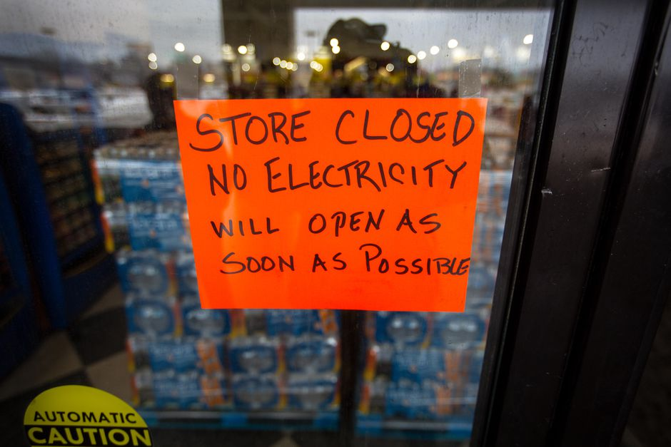
Winter Storm Season Training
Sign on the door that reads “store closed, no electricity, will open as soon as possible”
Rail blocking the street with sign that says “road closed by flood”
Based on materials developed by City of San Leandro Sustainability, Alameda County Office of Sustainability and Alameda County Health Emergency Preparedness and Response
v.8.2024
Notes:
Hi, this is {Name and Title, organization you are representing}
We are in the midst of _______ season in the Bay Area, so we are here to provide some guidance to help you prepare and respond to related threats such as wildfires, smoke, power shut offs, storms, flooding, heat waves, and more
We hope that you share this information with your friends and family to help build a community that is more resilient to the impacts of climate change
This workshop is based on materials developed by City of San Leandro Sustainability, Alameda County Office of Sustainability and Alameda County Health Emergency Preparedness and Response. When sharing or presenting materials, please provide credit, and modify with care.

Slide 2
About us
Notes:
A little bit about us and why we’re providing this training today:
[Provide background information about who is leading the training, the various offices]
{add information about your city or program here, and how participants might access slides or additional information after the presentation}

Slide 3
What you will learn today
Climate disaster preparedness resources and communication tools
Which community members are particularly vulnerable and how to prepare
Preparing for major seasonal hazards
Power shutoffs
Storms and flooding
Notes:
Today we will cover climate disasters preparedness resources and communication tools, including information about which community members are particularly vulnerable and how to prepare
Then we will dive deep into power outages, storms, and floods, and
Although we do not have a section thoroughly covering earthquakes, the preparedness tips we will cover are applicable to any hazard, including earthquakes.
Finally we will share resources you can use.

Slide 4
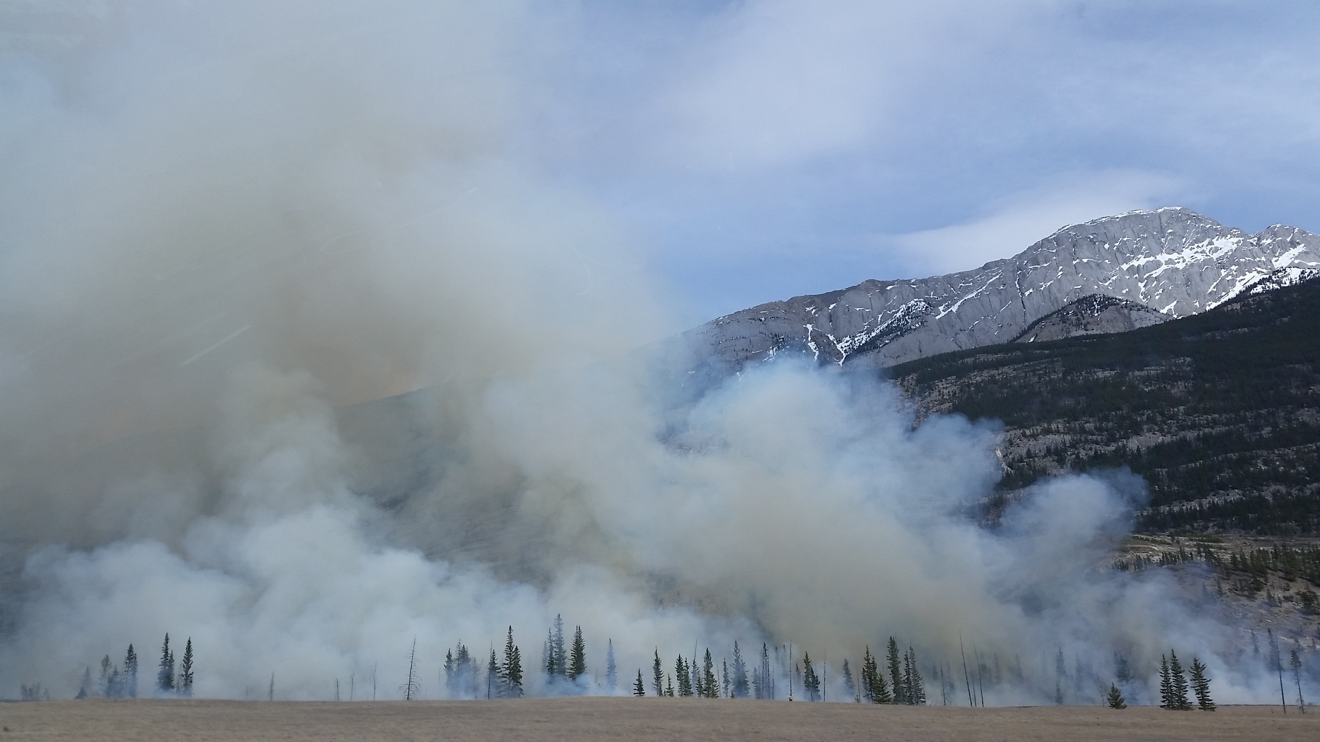
Notes:
Here are some headlines from 2023 and 2024, showing news about a local atmospheric river and power outage.
This demonstrates that these events are already happening and are going to continue.
These will have real impacts for our community – with infrastructure impacted, businesses closing, impacts to human health, and more.

Slide 5
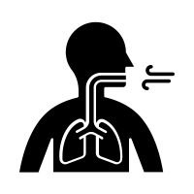
Whose Health Is Affected?
Older Adults
Children
People with Medical Conditions
People with Disabilities
Low Income Residents
Communities of Color
Indigenous Communities
People Living Alone
People who are Unhoused
Outdoor Workers
The Noun Project
Notes:
Who is going to be impacted by these types of events? Frontline communities will be impacted first and worst by climate change. Frontline residents may not have resources to adapt or respond. These include older adults, children, people with medical conditions, people with disabilities, low-income residents, communities of color, indigenous communities, people living alone, people who are unhoused, and outdoor workers.
Residents may also face multiple vulnerabilities at once.

Slide 6
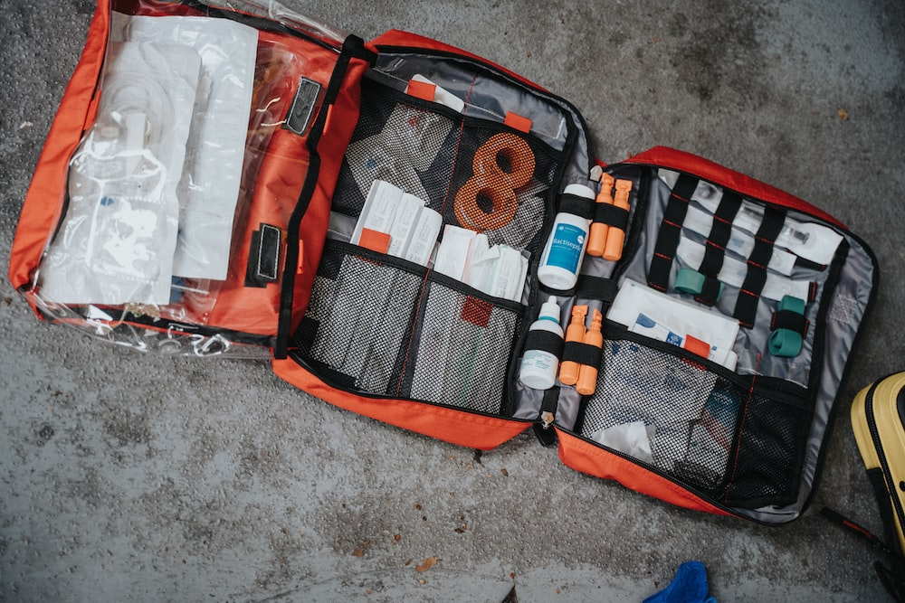
Climate Preparedness
Red preparedness kit with many different supplies
Photo by Mat Napa on Unsplash: Orange white and black bag photo – Free First aid Image on Unsplash
Notes:
To start off, we will cover climate preparedness. Disasters can happen unexpectedly, so it’s important to be prepared in advance
Before we dive in, can we get a show of hands, who has a disaster kit prepared at home?

Slide 7
Preparedness
Learn More →
www.Ready.gov.org
Sign up for emergency and evacuation alerts
Follow local agencies: Fire, Sheriff
Connect with your neighbors
Have designated meeting spots
Review with friends and/or family
Visit ready.gov/kit
Volunteer to help others
Strengthen your community
To learn more visit: acgov.org/ready/
involved
Notes:
The first step in being prepared is knowing the events that occur locally. You can learn about these events by signing up for emergency and evacuation alerts, which we’ll discuss later. And following Alameda County local agencies such as Fire and the Office of Emergency Services to stay up to date on events happening in the County.
Step 2 consists of having a plan. Review your evacuation plan with your family and/or friends and have a designated meeting spot for each evacuation. For example, know the quickest route to exit your area if a wildfire approaches your home.
Step 3 is making a preparedness prep kit. We’ll talk more about this on the next slide.
Lastly, step 4 is getting involved. You can sign up to volunteer to help others and strengthen your community by visiting acgov.org/ready/involved

Slide 8
https://www.ready.gov/kit
Recommended Items to Include in a Basic Emergency Supply Kit
Additional Items to Consider Adding to an Emergency Supply Kit
Prescription medications and glasses
Water and non-perishable food for several days
Infant formula and diapers
Extra cell phone battery or charger ​
Pet food, water and supplies for your pet
Battery-powered or hand crank radio that can receive NOAA Weather Radio tone alerts and extra batteries
Important family documents such as copies of insurance policies, identification and bank account records in a portable waterproof container
Cash and change
Flashlight and extra batteries
Emergency reference material such as a first aid book or information from www.ready.gov
First aid kit
Sleeping bag or warm blanket for each person. Consider additional bedding if you live in cold-weather climate
Whistle to signal for help
Dust mask, to help filter contaminated air and plastic sheeting and duct tape to shelter-in-place
Complete change of clothing including a long sleeve shirt, long pants and sturdy shoes. Consider additional clothing if you live in a cold-weather climate
Moist towelettes, garbage bags and plastic ties for personal sanitation
Fire extinguisher
Matches in a waterproof container
Non-sparking wrench or pliers to turn off utilities
Feminine supplies, personal hygiene items and hand sanitizer
Can opener (if kit contains canned food)
Mess kits, paper cups, plates and disposable utensils, paper towels
Local maps
Paper and pencil
Books, games, puzzles, or other activities for children
Notes:
Visit ready.gov/kit to view a checklist of items to include in your preparedness kit
pack water and food for several days, ideally 1 gallon of water per person per day
pack all items together in a durable bag and store it in an easily accessible place where it can be quickly grabbed when you need to go
family members can pack individual bags that include items such as clothes, personal belongings, and entertaining activities for kids
And don’t forget to pack essential needs for special family members such as pet food for your dog or life saving medications for an older adult in the family
Create a prep kit for your home, work, and car
And refresh your kits every year to ensure all food and medication are not expired

Slide 9
Communication
When an emergency threatens lives, it’s critical that we can reach you!
Alameda County Alert (AC Alert) sends you emergency messages to your chosen device for events in Alameda County
Sign up: ACAlert.org
QR code
Notes:
Visit ACAlert.org to sign up for our messaging system to be alerted of climate related disasters, earthquake information, and other hazards
When an emergency threatens lives, it’s critical that we can reach you
AC Alert sends you emergency messages to your chosen devices for events in the County
You can receive alerts as a text message, email, or even phone call to a land line

Slide 10
Local Social Media:
Alameda County Fire Department
@AlamedaCoFire on Instagram and X
@AlamedaCountyFire on Facebook
Alameda County Office of Emergency Services
@AlamedaCoAlert on X
@Alamedacountyoes on Facebook
Alameda County Sheriff’s Office
@ACSOSheriffs on X and Facebook
@Alamedacountysheriff on Instagram
Local NextDoor networks or Facebook groups
Notes:
Follow our local preparedness social medias to stay up to date on events in the County

Slide 11
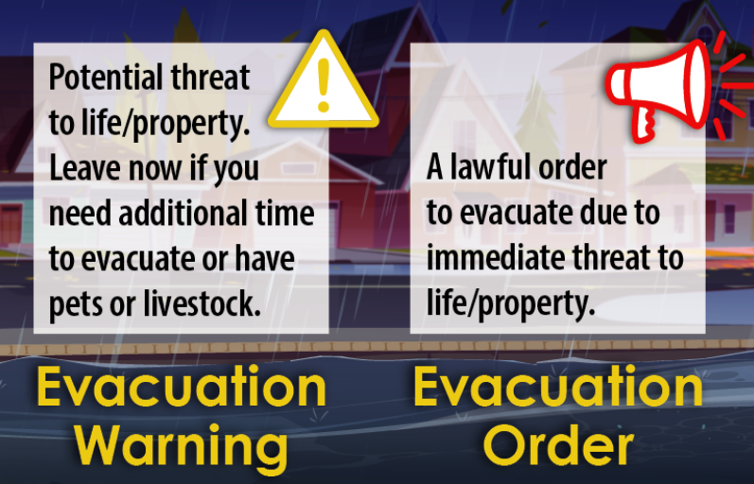
Evacuation Warning vs Evacuation Order
Evacuation Warning
Serious threat
Get ready to go
Go now if people or animals need extra time
Evacuation Order
Leave immediately
Your life is in danger
Shelter in Place
Stay indoors
Cal OES
Notes:
Depending on the severity and type of disaster, you could receive an evacuation order, evacuation warning, or shelter in place order
an evacuation order means leave immediately because your life is in danger
an evacuation warning means there is a serious threat, and you should get ready to go and you should go now if people or animals need extra time
shelter in place means stay indoors and take precautions
for example, when the air quality is very unhealthy for the general public

Slide 12
Evacuation Notifications
Find your zone to prepare for emergencies: protect.genasys.com/search
Evacuation Order​ | Red​ | Immediate threat to life. This is a lawful order to leave now. The area is lawfully closed to public access. ​
Evacuation Warning ​ | Yellow​ | Potential threat to life and/or property. Those who require additional time to evacuate, and those with pets and livestock should leave now. ​
Shelter in Place​ | Purple​ | Go indoors. Shut and lock doors and windows. Prepare to self-sustain until further notice and/or contacted by emergency personnel for additional direction. ​
Advisory​ | Blue​ | Be on alert and follow County recommendations ​
Evacuation Order Lifted ​ | Green​ | It is safe to return to your home. Be aware of your surroundings. ​
Map, pinpointing zone “OKL-E115”
Notes:
The County uses a tool called Genasys Protect (formerly ZoneHaven) to help communities prepare for evacuations BEFORE a disaster strikes. Genasys Protect works with local emergency planners and first responders to guide decision making around if, when, and where to order evacuations, while prioritizing the most vulnerable areas
You can download the Genasys Protect app with a smartphone or search your zone at protect.genasys.com/search
from there, you can enter your address to check the status of your area and share your location with Genasys for automatic population of data
if the zone is activated for an evacuation order, evacuation warning, or shelter in place, you will see additional information regarding the reason for the activation

Slide 13
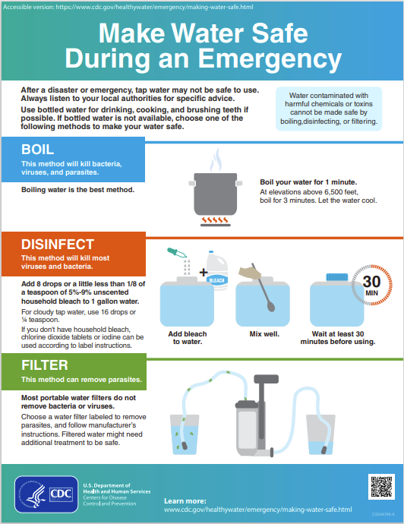
Safe Drinking Water
In addition to the 1-3 days of water in your preparedness kit, you can prepare to make water safe during a disaster:
Boil water for 1-3 minutes
Disinfect water by adding 8 drops of bleach to 1 gallon of water
Filter water with a commercial water filter
https://www.cdc.gov/healthywater/emergency/making-water-safe.html
Notes:
Safe drinking water may not be available during or after many climate related disasters
In addition to having a supply of bottled water, it is also helpful to learn how to treat water
The best method to treating water is to boil it
this will kill bacteria, viruses, and parasites
Boil for 1 minute at elevations below 6,500 ft
And boil for 3 minutes at elevations above 6,500 ft
Disinfecting water will kill most viruses and bacteria
Add 8 drops or about 1/8 of a teaspoon of 5-9% unscented household bleach to 1 gallon of water
Mix well and wait 30 minutes before using
Lastly, filtering water can remove parasites
There are multiple types of water filters so just follow the manufacturer's instructions
Note, filtered water might need additional treatment to be safe

Slide 14
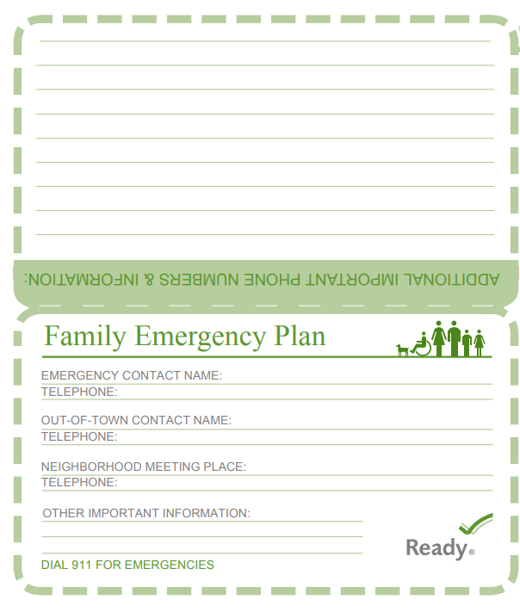
Emergency Contacts
Sister
LA family
Park
Write out your emergency contacts to identify who you can contact in these climate events if you need help
Include those you might want to check on or assist
Helpful to have out-of-town contacts as well
Write out emergency contact numbers
County emergency pocket guide includes Family Emergency Plan section
Parent
Aunt – has breathing problems
Community Organization
Church
Neighborhood Group
Parent Group
Reference: FEMA Ready.gov
Notes:
This visual is borrowed from FEMA’s Ready.gov, the emergency preparedness website, which shows a way to think about how residents can stay connected to one another.
This graphic highlights writing out phone numbers and names for an emergency contact, out-of-town contact, and neighborhood meeting places. In the sections for additional information, you can add information for community organizations and support networks that may help you during a disaster.
Write out your emergency contacts to see who you might need to check on, get in touch with, or ask for help during extreme weather events.

Slide 15
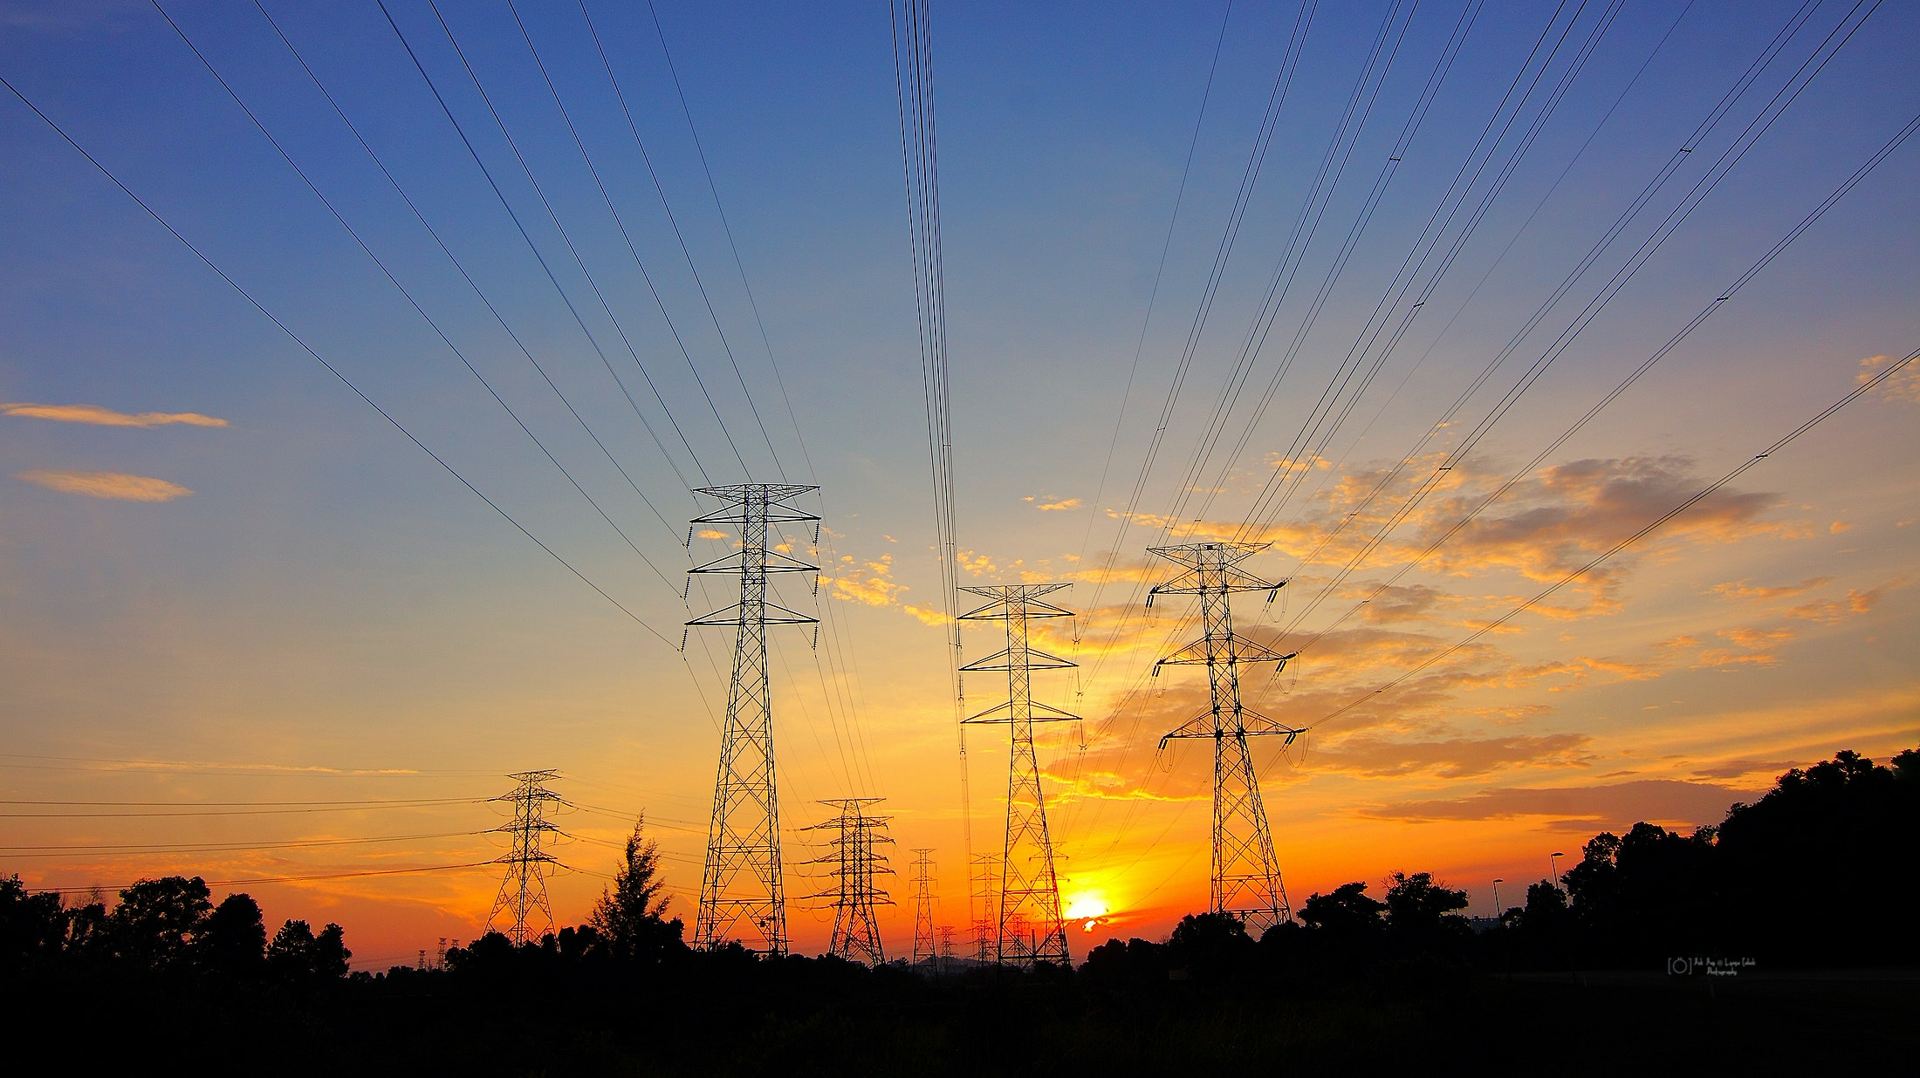
Power Shutoffs & Outages
Notes:
First, we will cover Power Shutoffs. The power may go out in storm conditions, but there may also be planned power shutoffs designed to limit the risk of wildfires.

Slide 16
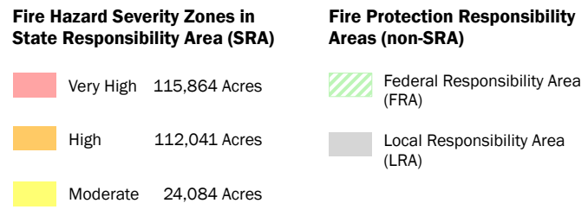
PG&E Public Safety Power Shutoffs (PSPS)
Utilities may temporarily turn off power to specific areas to reduce the risk of fires caused by electric infrastructure- this is called a Public Safety Power Shutoff
PG&E posts up-to-date information about PSPS events and power outages on its website:
pgealerts.alerts.
pge.com/updates/
CalFire Fire-Threat Map for Alameda County (6/15/23)
Humidity
High Winds
Fuel Conditions
Red Flag (Fire Risk) Warning
Observations
Notes:
PG&E may temporarily turn off power to high fire threat areas to reduce the risk of fires caused by electric infrastructure
These are called “Public Safety Power Shutoffs” or PSPS
If there is a PSPS event, PG&E will provide a map of the impacted areas and customers
There are certain conditions that trigger Public Safety Power Shutoffs
These include humidity, high winds, fuel conditions, red flag fire risk warning, and local observations
This High Fire Threat District Map is sponsored by the California Public Utilities Commission (CPUS) and is designed specifically for identifying areas where there is an increased risk for utility-associated wildfire
This fire threat map for the County was captured mid June 2023. There are several areas around the County where we can expect high fire risk zones

Slide 17
Be prepared for planned or unplanned power shutoffs, caused by storms or fire risk
Photo by Brett Sayles on Pexels
Notes:
You’ll want to be prepared for power shutoffs, even if they are not planned
PSPS impacts have declined with improvements to electric system infrastructure. PSPS are less frequent than they used to be, but they are still of concern, especially for those in high fire risk areas
Power outages can also happen during storms, so you should be prepared to carry on your daily activities without power during extreme storm events

Slide 18
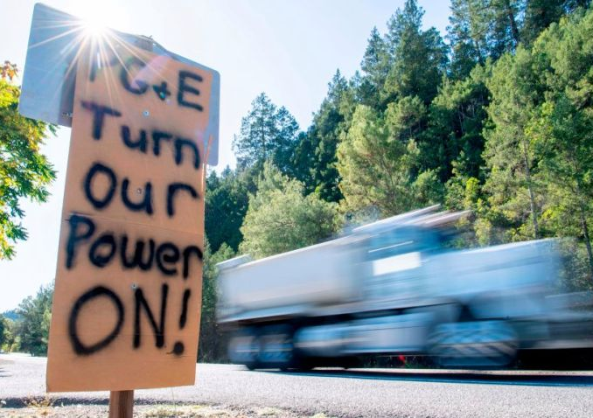
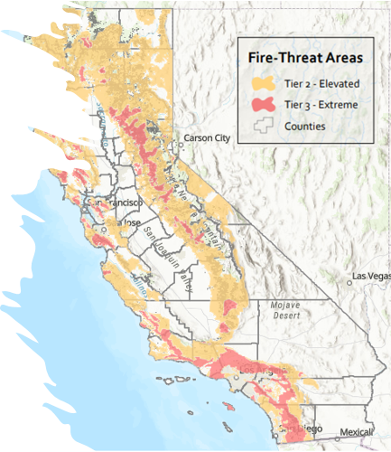
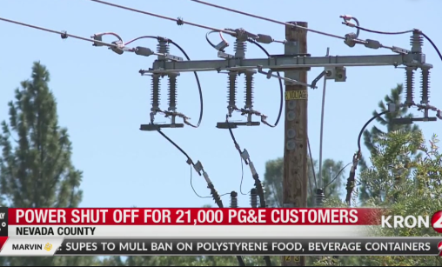
PSPS and Outages:
Who is most vulnerable?
Isolated individuals: may have limited communication tools
Children and older adults: who depend on care facilities
People with disabilities or medical conditions: who depend on equipment that requires electricity
Low-income individuals: may experience food insecurity due to food spoilage and may lose wages due to businesses being closed
Overlapping vulnerabilities: to heat and other hazards
Homes and businesses with powerlines in elevated or extreme wildfire risk areas
(During storms) people with powered sump pumps often in basements
Notes:
So who is the most vulnerable during power outages and shutoffs
When there is a power outage, lighting and communication methods such as cell phones may lose power,
So people who live in isolated areas may have limited communication tools
Children or elders in care facilities and their caregivers may have to change their routines if the facilities must close
People with disabilities or medical conditions who depend on electric medical and mobility devices
There’s a risk for food spoilage because power outages could last for 24-72 hours or longer
So Low-income individuals may be impacted if food needs to be thrown away
Additionally wages may be lost due to businesses being closed
People with overlapping vulnerabilities may be further impacted by power shutoffs
For example, people vulnerable to extreme heat may not be able to use AC to cool down in the event of a power shutoff
Homes and businesses with powerlines in the elevated or extreme wildfire risk areas are more likely to have their power shut off to prevent fire risk
And during storms, people may be affected if they have a powered pump removing rain or flood water from their homes

Slide 19
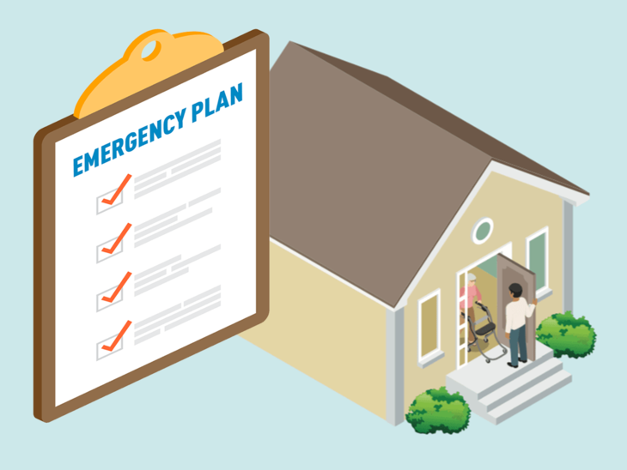
Existing Program Support for Households
Medical Baseline Program
Extra PG&E notifications in advance of PSPS events
PG&E Portable Battery Program for income qualified participants
Disability Disaster Access & Resources Program
Portable backup batteries, hotel accommodations, accessible transportation, food vouchers
Community Resources for Independent Living (CRIL) in Hayward, CA – 510-881-5743
Center for Independent Living (CIL) in Berkeley, CA – 510-841-4776
Reference: PG&E
Notes:
There are some support programs to aid people during power outage events
The main program from PG&E is the Medical Baseline program. It is for any person with an eligible medical condition or a medical device that uses power. Once you enroll in the program, this allows you to get a bill reduction for the use of electricity for life saving devices, as well as extra PG&E notifications – they will call you or even come to your door to make sure that you know about planned shutoffs.
PG&E also has a Portable Battery program which allows you to get a fully subsidized battery for use during these events.
Additionally, There is a Disability Disaster Access & Resources Program that is run by Independent Living Centers, serving people with disabilities. They provide support that includes portable backup batteries, hotel accommodation, and food vouchers.
CRIL serves southern and eastern Alameda County, and CIL serves Northern Alameda County including Berkley, Oakland, Alameda, Emeryville, Piedmont, and Albany

Slide 20
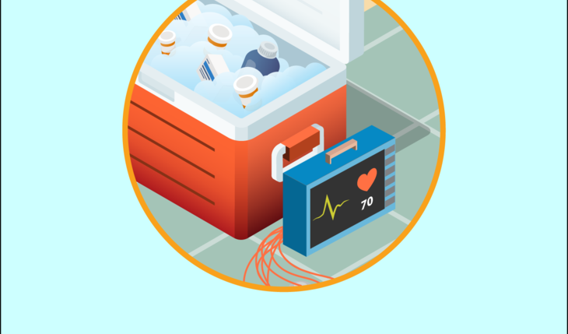
Gaps in Support
Support for people not on medical baseline, but require refrigerated medication (i.e. insulin) or other equipment
Medical baseline has a high access barrier with documentation and may be difficult to get on for people with low English skills even if they qualify
Notes:
However, there are some populations to be aware of that may not be served by current program offerings.
For example, people with refrigerated medication will be affected, but are not served by the Medical Baseline program.
Medical Baseline requires documentation from a doctor, which may take several steps to obtain, and require language skills.
The portal is also only available to government agencies, not community health providers.

Slide 21
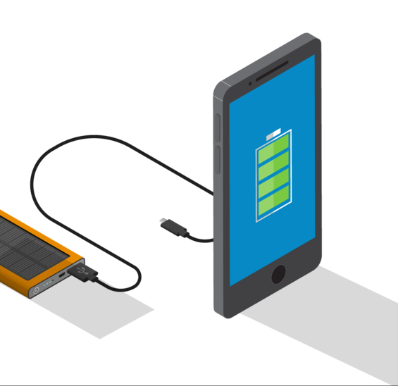
PSPS and Outages: How to prepare and stay safe
Fill medications early
Stock up on non-perishable food
Make your own ice to cool food and limit opening the fridge once power is off
Find “buddies” for those living alone
Call 2-1-1 or the Non-Emergency Power Shutoffs Hotline at 833-284-3473 for help
Have backup keys for electronic keys and locks
During shutoff, unplug large electrical appliances that may surge when power returns
Keep flashlights and solar/battery lanterns on hand
Reference: PG&E
Notes:
So how can you prepare and stay safe?
(read slide)

Slide 22
Storms & Flooding
Rail blocking street with sign that says “road closed by flood”
Photo by Phillip Flores on Unsplash: Yellow caution wet road sign on gray concrete road photo – Free Annangrove nsw Image on Unsplash
Notes:
Next, we will review storms and flooding. Flooding is the most common natural disaster in the US, so it's important to understand the risks and know what to do if a flood occurs

Slide 23
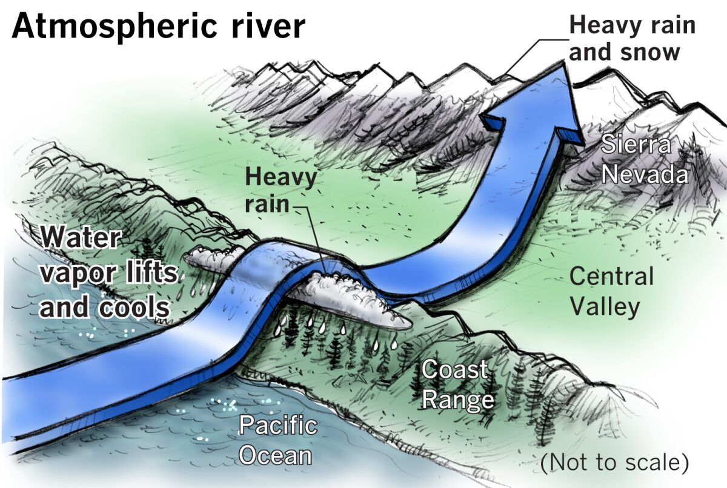
Atmospheric Rivers & Floods
"Rivers in the Sky"
Flash Flood: flooding that begins a few hours, and sometimes even minutes, after intense rainfall
Flood Watch
Conditions for floods are favorable and possible
Flood Warning
Flooding is imminent or happening
Paul Duginski/ Los Angeles Times
Notes:
Atmospheric rivers are long, narrow regions in the atmosphere that transport water vapor. You can think of them as rivers in the sky.
Atmospheric rivers that carry large amounts of water vapor and strong winds can create extreme rainfall and lead to flooding and mudslides
Flash floods begin within a few hours to even minutes after intense rainfall
This gives people little time to prepare and take precautions
Flooding occurs in areas where the ground is unable to absorb all of the fallen water
Urban areas are particularly vulnerable to flash flooding because of the impervious paved surfaces
A flood warning is when flooding is imminent or happening
A flood watch is when conditions for floods are favorable and possible
What are atmospheric rivers? | National Oceanic and Atmospheric Administration (noaa.gov)
What Is Flash Flooding and How Can You Stay Safe - The New York Times (nytimes.com)

Slide 24
Mudslides
Heavy rains can cause mudslides
Sounds like trees cracking and big rocks knocking together
A low rumble turns into a roar as it gets closer
At-risk areas
Steep slopes with a lack of vegetation
Construction areas
Burned land from wildfires
Move to high ground and take cover
https://www.acpwa.org/about-us/roadclosure.page?
Mudslide blocking roads
Kenneth Song / Santa Barbara News
Notes:
Mudslides can happen when water rapidly accumulates on the ground
Mudslides can contain
Water, mud, rocks, and debris
Mudslides can sound like trees cracking or big rocks knocking together
Some describe it as sounding like a freight train
A low rumble may become a roar as a mudslide gets closer
Watch for mudslides in areas with
Steep slopes and runoff
Construction
Burned land from wildfires
And tilting telephone poles, trees, or fences are strong indicators of a mudslide
If you see a mudslide starting, quickly move to the nearest high ground in a direction away from the path.
Mudslides can cause road closures
Which will be posted to the Public Works site for the County
Stay Safe in Severe Storms - English (listoscalifornia.org)
Landslides and Mudslides (ca.gov)

Slide 25
Wind Alerts
Dog in windy weather with
its fur blowing all over face
Wind Advisory
Sustained winds of 31-39 MPH for an hour or more AND/OR wind gusts of 46-57 MPH for any duration are expected
High Wind Warning
Sustained winds of 40 MPH or higher for an hour or more OR wind gusts of 58 mph or higher for any duration are expected
High Wind Watch
When high wind warning conditions are possible
Notes:
Storms bring strong winds ranging in intensity
Strong winds may produce difficult driving conditions for vehicles, knock down trees, powerlines, fences, and temporary structures. Loose or unsecured objects may be blown away
Read slide
Watch/Warning/Advisory Definitions (weather.gov)

Slide 26
Storms and flooding: Who is most vulnerable?
Older adults & people with disabilities: consider evacuating early to ensure extra time due to mobility impairments
People with medical conditions: flood waters may contain diseases that can cause or worsen health impacts
People living in older homes: water may leak into the house due to deteriorated foundation
Low-income individuals: may not have access to transportation such as a car to evacuate
The unhoused: very susceptible to the impacts of floods and storms. Lives and belongings are at high risk.
Notes:
To allow extra travel time, older adults and people with disabilities may consider evacuating during evacuation warnings or at any point that they feel unsafe. Never wait to be told to leave an unsafe situation
read slide

Slide 27
Flood Hazard Areas
View FEMA’s website to see if you are in the FEMA floodplain.
Alameda County Local Hazard Mitigation Plan (acgov.org)
Notes:
Here is a map showing the flood hazard areas for the County
Neighborhoods near the San Lorenzo Creek, Alameda Creek, San Antonio Reservoir, the bay shoreline, and more are at high risk of flooding
You can view FEMA’s website to see if you are located in the FEMA floodplain.
The terms 100-year flood and 500-year flood are used to describe the chance of a flood happening.
A 100-year flood is a flood that has a 1/100, 1%, chance of occurring each year.
So, this does NOT mean that a flood of this magnitude will only occur every 100 years.
So, a 500-year flood event is a flood that has a 1/500, 0.2%, chance of occurring each year.
However, many cities all over the country are experiencing 100-year and 500-year floods much more often. This is due to climate change

Slide 28
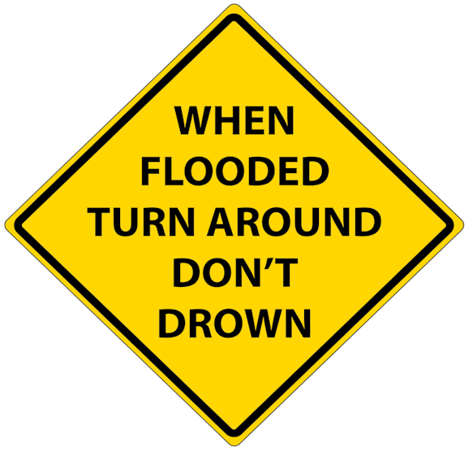
Storms and flooding: How to prepare and stay safe
Turn around, don't drown
Never walk or drive through flood waters
Remove or secure outdoor hazards
Place sandbags in low-lying spots
https://www.acpwa.org/prepare-for-winter-storms.page
Keep your car fuel tank at least half full of gas
Never touch or drive over a fallen power line
Do not return home until safe
Yellow, diamond shaped, road sign,
“when flooded turn around, don’t drown”
Notes:
Turn around, don't drown
Never walk or drive through flood waters
Never go around warning barricades
People and items including cars can easily be swept away in fast moving flood waters
6 inches of water can knock you over
Just 1 foot of water can float many vehicles
Avoid contact with flood water
There may be pollutants, debris, downed and charged powerlines, or animals such as snakes hiding in floodwaters
If water does contact your skin, wash the area with hot, soapy water or use sanitizer to clean the area as soon as possible
When high winds are expected, remove or secure any outdoor hazards such as patio furniture, garbage cans, grills, children's toys, etc.
Place sandbags along the perimeter of the house to divert water away from the foundation
Place sandbags in low-lying spots
Visit the County’s Public Works website to view where sandbags are available for pickup
You may need to evacuate quickly
So, keep your car gas tank at least half full
Never touch or drive over downed power lines
Charges may electrocute you
If a powerline falls on your vehicle, call 911 and remain inside until a professional can remove it
Do not return home until safe
After a flood, your home may be contaminated with mold or sewage which can cause health risks
So, dry your home out and clean or remove all mold contaminated items
Wait for further instructions from authorities or professionals before turning on or off electricity and gas
Check with local authorities to ensure your drinking water is safe and has not been contaminated
Wear protective clothing when cleaning up such as a mask, long sleeved shirt, pants, work gloves, and heavy-duty boots
Stay Safe in Severe Storms - English (listoscalifornia.org)

Slide 29
How can we support you in becoming more resilient to climate hazards?
What do you need before, during, and after climate events?
How do you want to receive info?
What kinds of trainings do you want, and where?
What questions do you have?
Volunteers filling up bags with sand
Image: Alameda County Fire Department
Notes:
This concludes our presentation
Now, we’d like to open a conversation – how can we support you in becoming more resilient to climate hazards?
Raise your hand if you have a response – we want to hear what you need to support those in your community, how you can receive information, and how can we encourage these protective actions in the community.
(discuss)
Thank you, we will learn from what you shared today

Slide 30
What questions do you have?

Slide 31
Thank you For helping us build a more resilient community!
Sign on door that reads “store closed, no electricity, will open as soon as possible”
Rail blocking street with sign that says “road closed by flood”
Notes:
Thank you for attending our training, and for everything you do to help make our community healthier and more resilient
{Please stay in touch [share contact information on slide or verbally]}

Slide 32
Resources
Photo by Nick Fewings on Unsplash: Assorted-title book lot placed on white wooden shelf photo – Free Reading Image on Unsplash
Notes:
The next couple of slides include lists of links that may be useful to you.
We encourage you to sign up for the best alert system for you, in your county and your city if applicable.
You can see here multilingual resources to help you and your communities prepare.

Slide 33
PSPS Resources
PG&E real-time PSPS Updates
PSPS alert sign up from PG&E
Power outage alerts and information (pge.com)
PG&E Prepare for PSPS
PG&E Medical Baseline Program
PG&E Vulnerable Customer Program
Disability Disaster Access & Resources Program
PG&E PSPS support resources, including translated outreach material
PG&E Community Resource Centers
California Health and Human Services PSPS Resource Guide
California Public Utilities Commission Fire-Threat Map
Notes:
PG&E provides several resources for planned power shutoffs – see those at these links.

Slide 34
Flood Resources
Get Flood Ready - Zone 7 Water Agency
Flood (fema.gov)
Alameda County Local Hazard Mitigation Plan (acgov.org)
County Sandbag Info
FEMA Floodplain
Public Works Road Closures
Notes:
Here are links to storm and flood related resources

